Slide 1
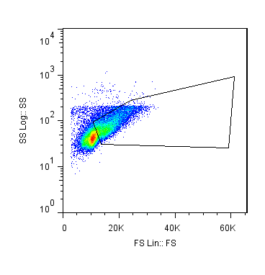
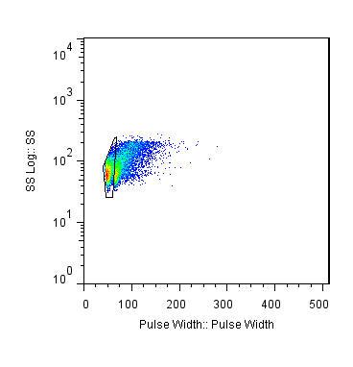
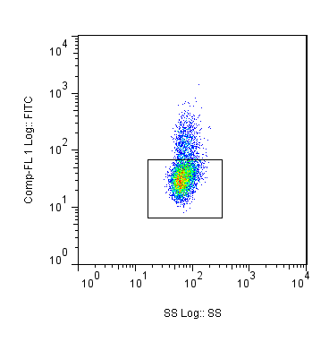
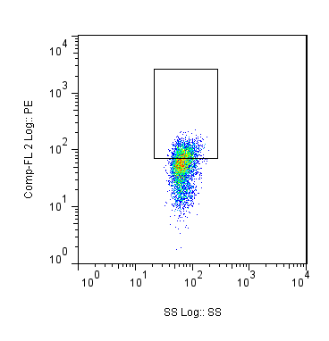
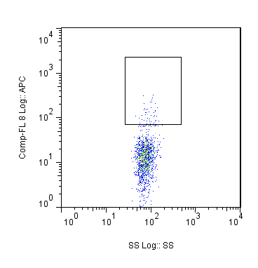
CD43+
CD19+ Pro B
Lymphocytes
Single Cells
Side Scatter
Side Scatter
IgM
CD43
CD19
IgM-
Forward Scatter
Pulse width
Side Scatter
Side Scatter
Side Scatter

